Slide 1
G-V-059-01 能看懂常見的句型。
簡單動名詞
Simple Gerunds:
Studying in Australia

Slide 2
Learning Goal
學習目標
Students can understand common sentence patterns in gerunds in English.

Slide 3
Grammar and Patterns
文法/句型 解說

Slide 4
Simple Gerund Explanation 簡單動名詞解釋
“V-ing”
Gerunds are special kinds of verbs.
動名詞是一種特殊的動詞。
These verbs take the role of another part of speech in some situations.
在某些情况下，這些動詞充當另一個詞性。
A gerund is when a verb is used as a noun.
動名詞是指動詞用來當作名詞。
A verb can take the form of the noun when the ending “-ing” is added (V-ing).
當結尾加上“-ing”（V-ing）時，動詞可以採用名詞的形式。

Slide 5
Simple Gerund Samples 簡單動名詞例句
For example, the subject “V-ing” are nouns in these sentences.
例如，主語“V-ing”是這些句子中的名詞。
Cooking is one of my favorite activities.
烹飪是我最喜歡的活動之一。
作主詞:
A good way to stay healthy is swimming.
保持健康的一個好方法是游泳。
作補語:
I finished reading the book in one week.
我在一周內讀完了這本書。
作受詞:

Slide 6
The Story
本集故事

Slide 7
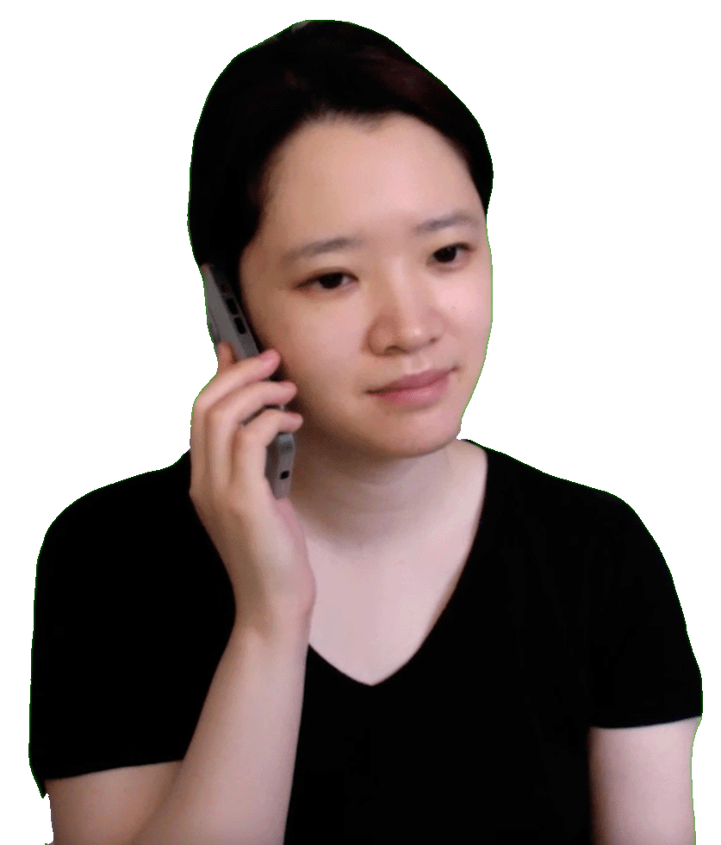
The Story 本集故事
Fiona: Hey Tony! I heard you are thinking about studying in Australia.
Tony: That’s right Fiona. Improving my English is important to me, and I think living in Australia can help.

Slide 8
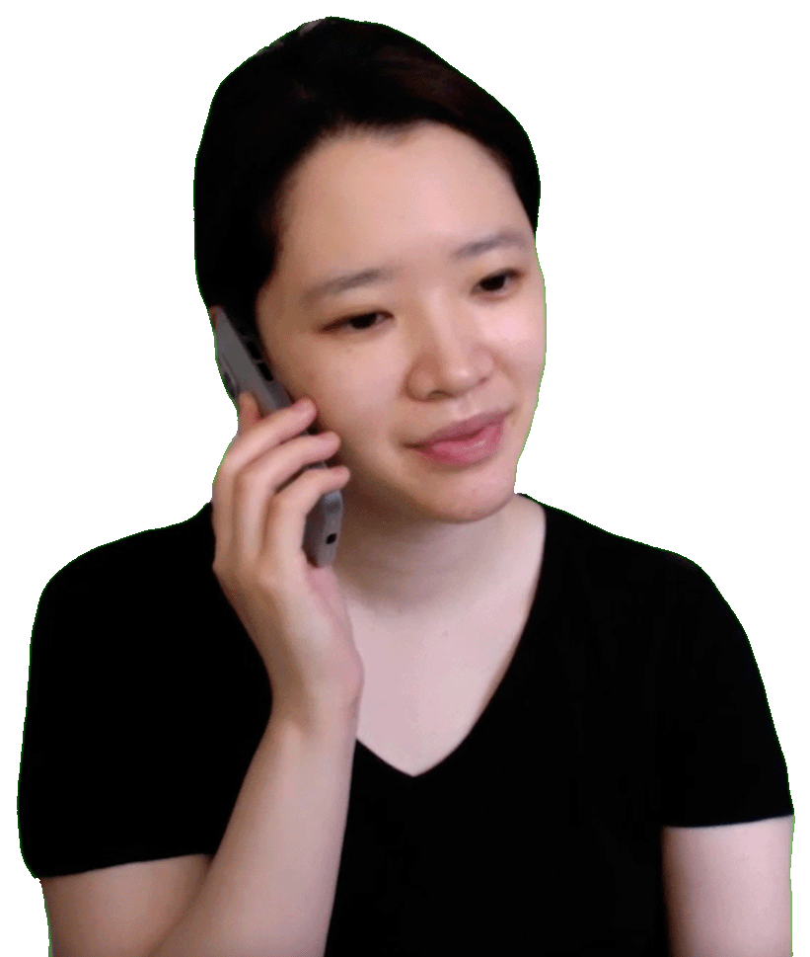
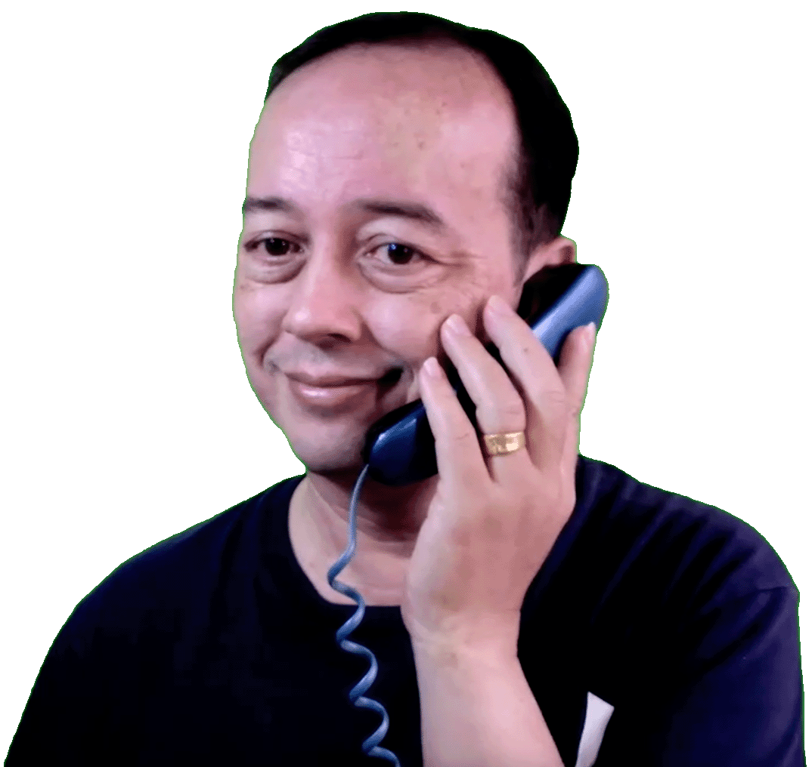
The Story 本集故事
Fiona: That would be great. Being in Sydney, I could show you around.
Tony: My school might not be far from your home. I need to study, but I’m sure there will be time for relaxing.

Slide 9
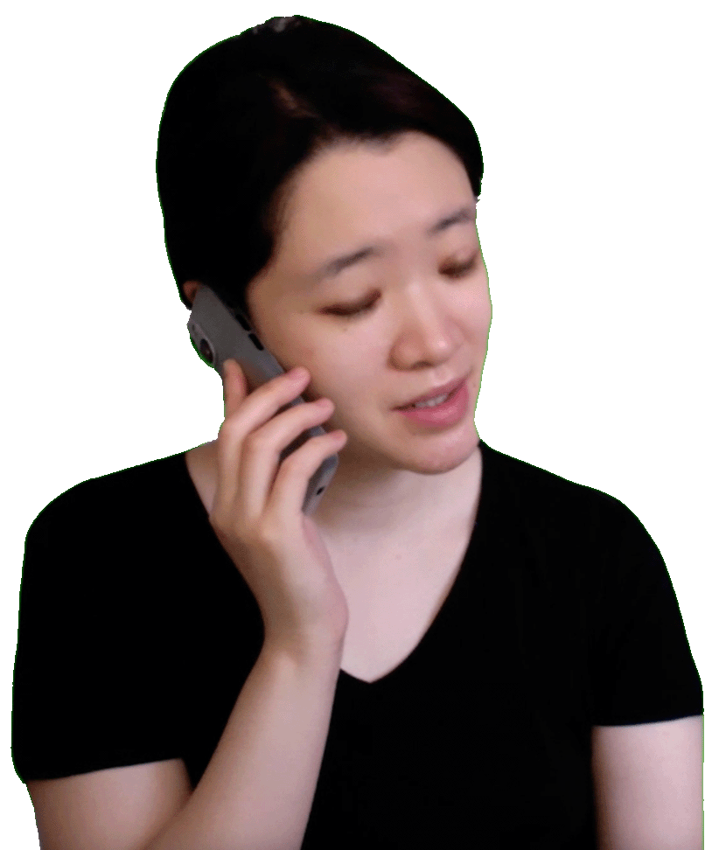
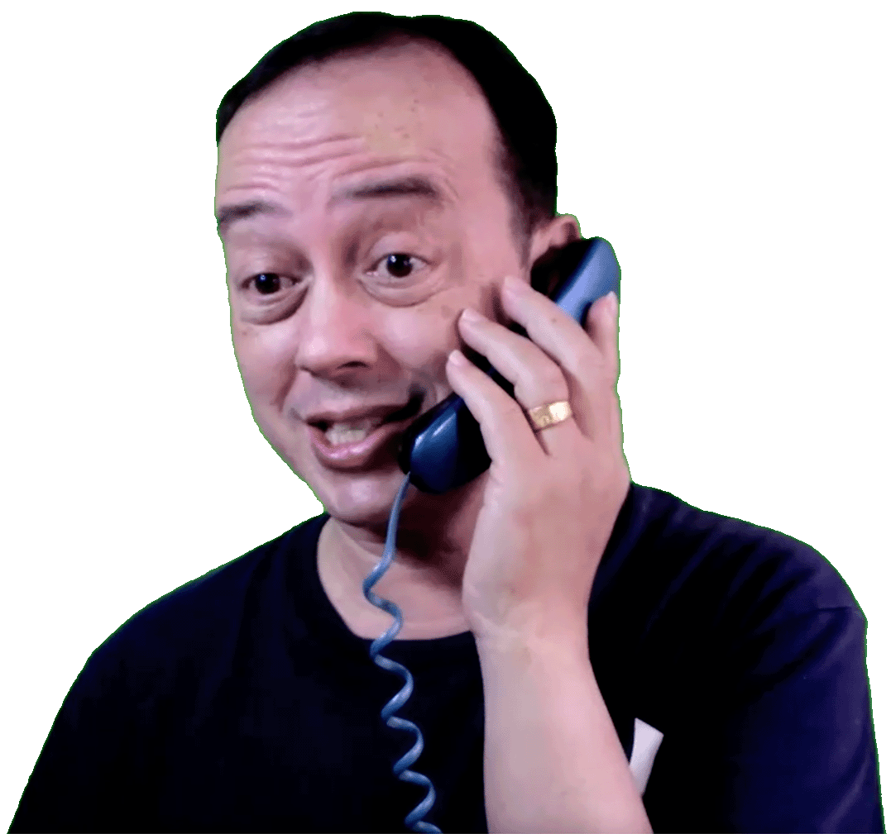
The Story 本集故事
Tony: What do you think about doing with our free time?
Fiona: Surfing is something many people like to do. Maybe fishing is something you want to do.

Slide 10
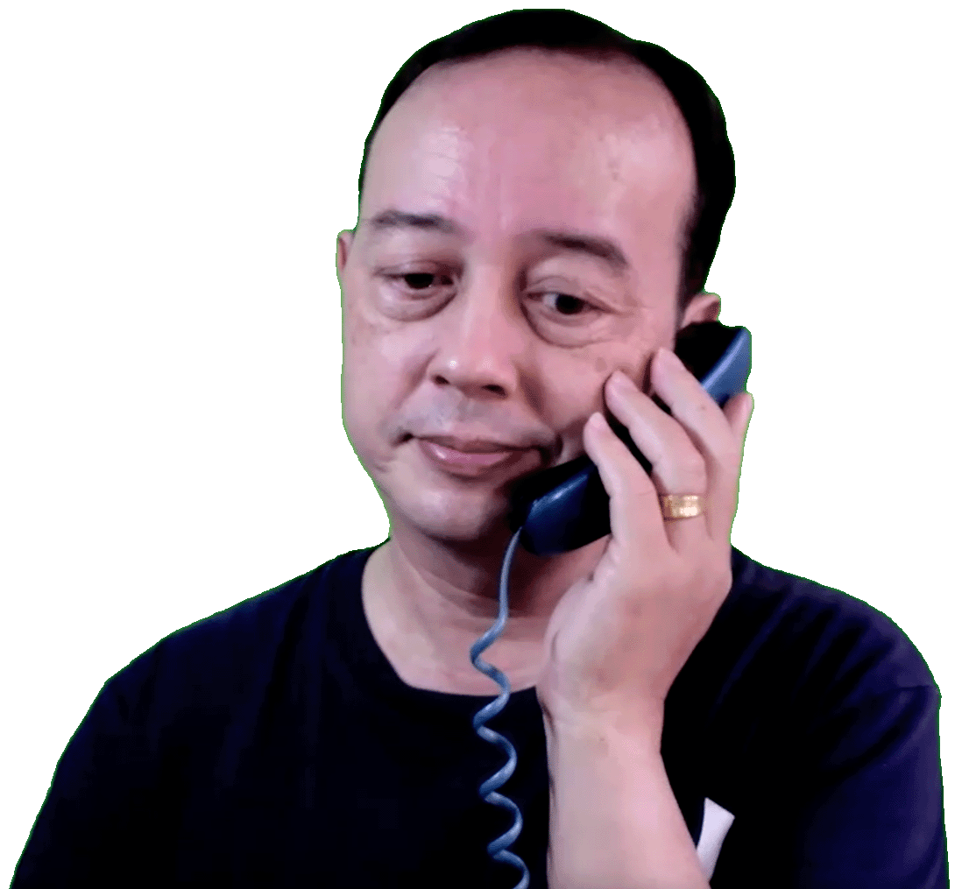
The Story 本集故事
Tony: Surfing sounds scary, but fishing sounds nice. Exploring Sydney is something I really want to do. I need your help for that.
Fiona: Surfing is not as scary as you might think. Showing people our beautiful city is something I love to do.

Slide 11
The Story 本集故事
Tony: I really appreciate being your friend. Thank you.
Fiona: You’re welcome. Have a safe journey.

Slide 12
Three Sample Sentences
三個例句

Slide 13
Simple Gerund Samples 簡單動名詞例句
1) Studying English in Australia is a goal of many students.
2) After moving to New York, making friends became his first goal.
3) Opening her gift was her favorite birthday memory.

Slide 14
Summary
by a Foreign Teacher
外師總結

Slide 15
Summary by a Foreign Teacher 外師總結
Gerunds are useful to use when writing to emphasize that some action is important. We make it into a noun.

Slide 16
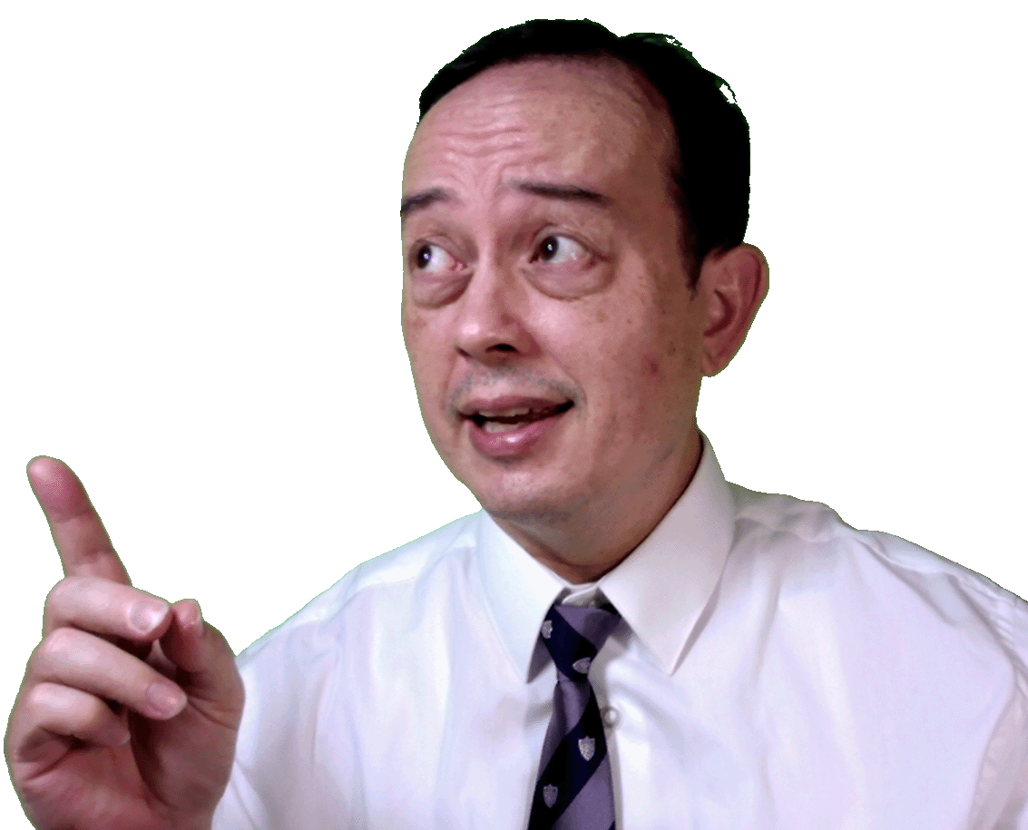
Summary by a Foreign Teacher 外師總結
Here is an example:
Cooking is not something
I am good at.
How can you tell the action word is a gerund or a noun? Because the word right after it, “is.” Everything after the word “is” describes the action of cooking.

Slide 17
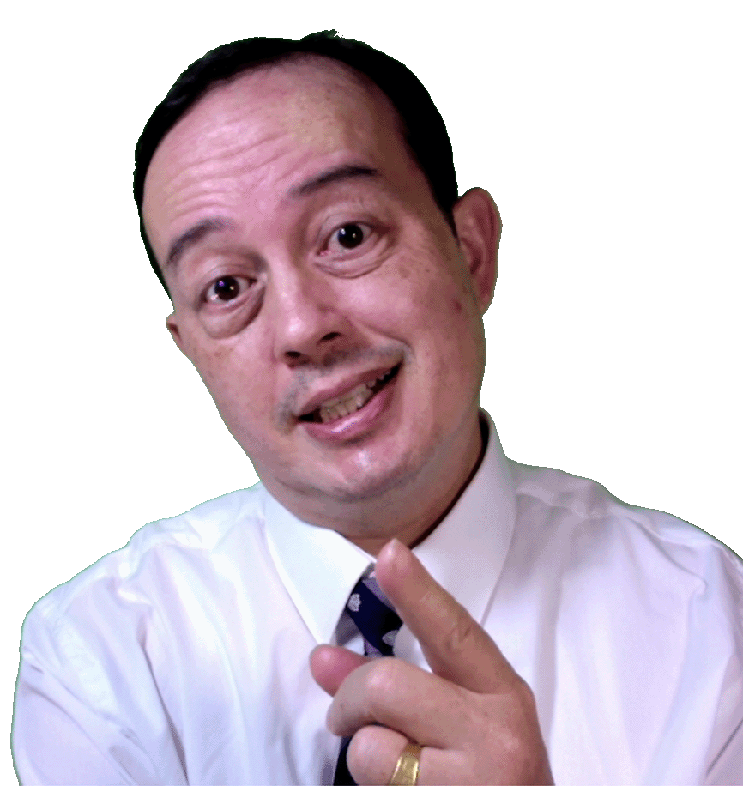
Summary by a Foreign Teacher 外師總結
Gerunds can be confused with present participles of verbs.
Present participles follow the form:
Subject is/am/are/ V-ing something.

Slide 18
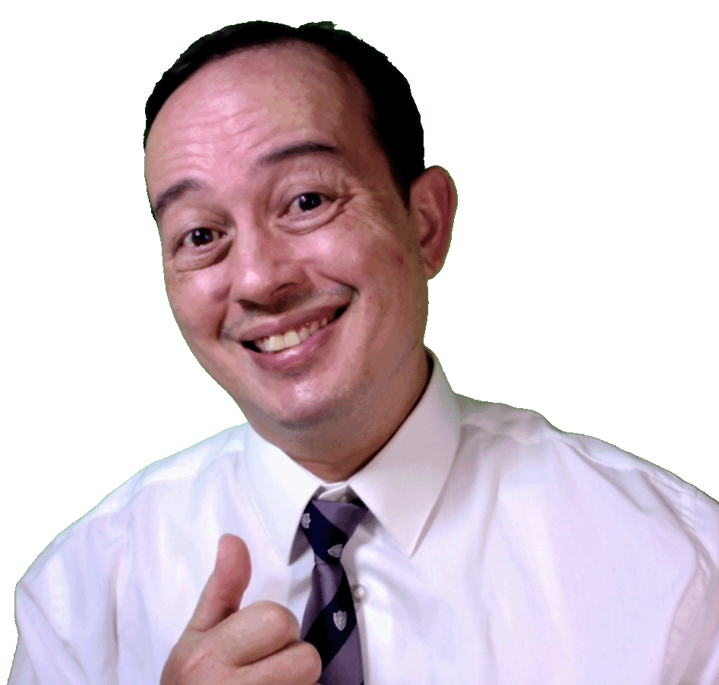
Summary by a Foreign Teacher 外師總結
Here are some examples of present participles:
He is swimming in the river.
We are taking the test now.
They are resting in the hotel.

Slide 19
Famous Saying or Idioms
名言佳句/成語

Slide 20
Famous Saying / Idioms 名言佳句/成语
Turning over a new leaf
Meaning:
to make a big change in one’s life
Sentence:
After transferring to a new school,
the student believed turning over a new leaf
would be a good idea.

Slide 21
本頁面以下為附加題目，做為參考
要不要放在影片裡面，由NCUE決定

Slide 22
Story Comprehension
短劇理解
Let’s check your understanding of the
story with these two questions.

Slide 23
Story Comprehension 故事理解
Question 1: Where does the woman in the story live?
(A) Australia (Answer)
(B) Taiwan
(C) Canada
(D) United States

Slide 24
Story Comprehension 故事理解
Question 2: What is NOT something that Tony wants to do in Australia?
(A) Exploring
(B) Fishing
(C) Relaxing
(D) Surfing (Answer)

Slide 25
Grammar Comprehension
文法理解
Let’s check your understanding of the
grammar with these two questions.

Slide 26
Grammar Comprehension 文法理解
Question 1: Which of these sentences has a gerund?
(A) Getting good grades is important to her. (Answer)
(B) He is not getting good grades right now.
(C) They were sleeping in their tent.
(D) We will be traveling to Australia this summer.

Slide 27
Grammar Comprehension 文法理解
Question 2: Which of these sentences is NOT
a gerund?
(A) Visiting Disneyworld is something I want to do.
(B) Cindy’s dream is studying in Canada.
(C) In the summer, the people are swimming at the beach. (Answer)
(D) The dog likes sleeping in the dog house.

